Slide 1


Slide 2

A Basic Introduction to the Linux Commandline

Slide 3




Hubble Bubble
Notes:
Before we begin in the office Linux if often likened to scene from Hamlet.
Linux is not only case sensitive, but also follows exacting syntax meaning if you put in PUPPY tails when you only need puppy tails, or the eye of newt goes in before the tears of a cat, either nothing will happen or something totally unexpected.

Slide 4

Accessing the Terminal
Now you have started into a in the GUI, in many ways this is very similar to the Windows or Mac OSX Operating Systems.
To get the most out of Linux you will want to access the terminal from time to time. To do this you will need to look for the below icon on the launch bar on the left.
Notes:
Win & Mac are entirely GUI.
Linux Command line is the first stepping stone to the HPC systems at NBI

Slide 5
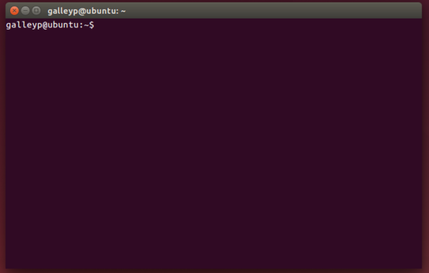
Accessing the Terminal
This will result in a window like this.
Notes:
Win & Mac are entirely GUI.
Linux Command line is the first stepping stone to the HPC systems at NBI

Slide 6
The Basics
Basic flags, commands and getting around.
Notes:
They have the option of playing with the commands as I talk about them or waiting to use them at the exercise step.
Either way note that Linux is case sensitive

Slide 7
The Basics
Commands
So now we are in the Terminal how do we get the computer to do something?
You give the computer a command.
Start with some of the informative commands then move onto navigational commands.

Slide 8
The Basics
Commands
Command | Details
who | This will display information about who is logged on, both yourself and others.
whoami | This will display information about the current user i.e. You!
ls | ls is short hand for LiSt. It will display all the visible files and sub directories within the directory that you are currently in. The files will be listed alphabetically by default but this can be altered with flags.
pwd | This will Print the Working Directory. A fancy way of asking the computer to display information about where you are and what directory you are currently working in.
apropos Keyword | This command followed by a keyword will provide you with information on commands that are related to that keyword.
man Command | This will provide you with the electronic manual for the given command.
Notes:
Highlight the PWD command, LS command and MAN command

Slide 9
The Basics
Commands
man Command
When you get stuck with a command then man is your friend. Its manual pages display a description, instructions of its use and how all the flags will interact with this command.
man ls – this will provide you with the manual for the ls command as displayed below.

Slide 10
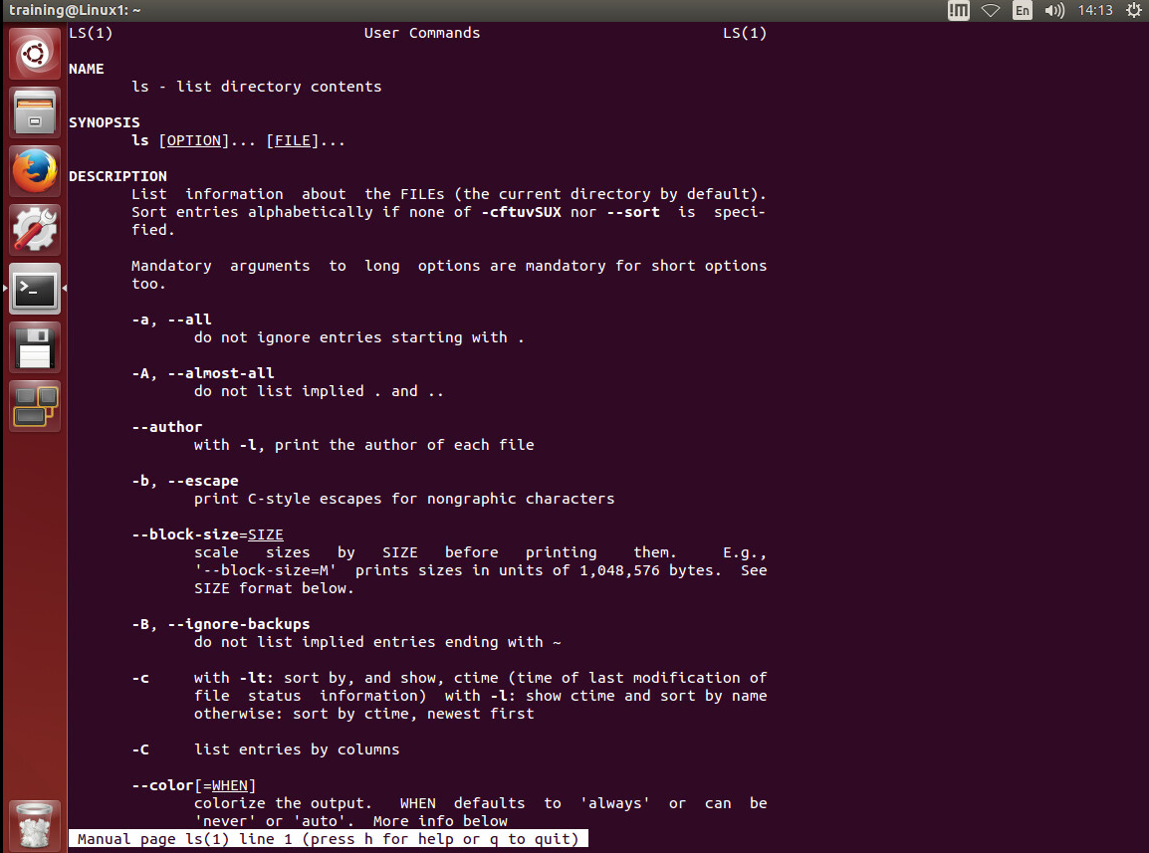
The Basics
Commands

Slide 11
The Basics
Flags
Using the commands pwd and ls you can gather information about the digital world around you, using flags will give you even more control.
We will place the flags behind the ls command for demonstrative purposes

Slide 12
The Basics
Flags
Flag | Details
ls -a | LiSt All – This will list all of the files in the directory including the hidden dot files.
ls -l | LiSt Long – This will list all the files and/or subdirectories with detailed information such as file size, date modified etc.
ls -t | LiSt Time – This will sort the list into a chronological order based on modification time.
ls -tu | This list will list them chronologically based on the last access date.
ls -R | This list will include the content of subdirectories.
ls –S | LiSt Size – This list will be based on the size order.
ls –h | LiSt Human – this will make the list file sizes in human readable format for example the size would be 1.0MB instead of 1004638
ls -r | LiSt Reversed – This will list the files in a reverse alphabetical order.

Slide 13
The Basics
Flags
It is possible to combine flags for instance
ls –alh
would display all files including hidden in the long format human readable.

Slide 14
The Basics
Getting Around
The commands for getting around the directories and file structures are really simple.
Inverted tree like design with the root directory at the top, the user home directory and other essential folders below that, and the general directories/subdirectories below this.

Slide 15
The Basics
Getting Around

Slide 16
The Basics
Getting Around
Command | Details
cd .. | Change Directory - to one level up the tree.
cd ~ | Change Directory - to the home directory
mkdir Directory | Make DIRectory – this creates a new directory within the current working directory
rmdir Directory | ReMove DIRectory – This will remove the named directory, It must be both empty of files and within the current working directory
rmdir –r Directory | ReMove DIRectory – the r flag on this command will along with its contents
rm –i Directory | ReMove – the i flag on this command will make it so there is user interaction, i.e. the computer will ask for confirmation
rm –ir Directory | ReMove – the combination ir will remove all files within the directory and ask for confirmation for each file within it.
mv filename new_filename | MoVe – This will move the file to a new location
cp filename new_filename | CoPy – This will make a copy of the file under the specified name.
Notes:
Highlight the space in the CD .. Command and that .. Means the parent directory
Advise that they might need to use shift+| or ¬ to get the ~

Slide 17
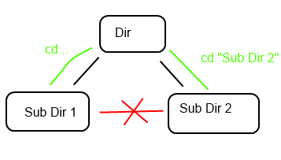
The Basics
Getting Around
One thing to note is that you cannot move directly between directories on the same level using the cd command alone, you have to either go up a layer using the cd .. then cd to the directory or combine the commands.

Slide 18
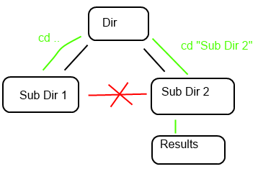
The Basics
Getting Around
You can take this one step further and add in further sub directory if known that you want to go to. cd ../”Sub Dir 2”/Results

Slide 19
The Basics
Getting Around
You can also use the absolute path of the directory if you know it. Absolute paths are always from the root directory
In this case it would be
cd /usr/usr1/Dir/”Sub Dir 2”

Slide 20
The Basics
Making Folders
mkdir filename - Will create a new directory or folder with the specified name assuming that one by this name does not already exist. This directory will be created within the directory you are currently occupying.
Notes:
This is assuming that the directory doesn’t all ready exist

Slide 21
The Basics
Removing Files & Folders
rm filename – This will delete a file. Using flags with this can speed up the deleting process by automating it and removing the need for user confirmation.
rmdir directoryname – This will delete a directory as long as the directory is empty

Slide 22
The Basics
Moving Files
mv filename – This can move one or more files to a new directory
$cd results
$ls
Result1.c Result2.c Result3.c Result4.c invalid results/
$mv * invalid results/
This will move all the files out of the results directory and move it to the invalid results folder.
(you’ll learn about * later)

Slide 23
The Basics
Moving Files
mv filename – even though this is the move command it can also be used to rename a file or directory
$ls
sample.txt
$mv sample.txt sample1.txt
$ls
sample1.txt

Slide 24
The Basics
Copying Files
cp filename /new/location/. – this will copy a file to the specified location.
cp filename /new/location/newname – this will copy a file to the specified location under a new name.
cp -R /original/location /new/location/. – this will copy a folder and all its contents to the specified location.

Slide 25
The Basics
Linking Files
ln –s filename linkname – this will create symbolic link, or softlink.
This acts very much like a shortcut file in a GUI pointing to the file or directory defined in filename and with the name defined in linkname

Slide 26

The Basics
Permissions
chmod or Change Mode is used to change the permissions on a file. These changes can be either adding or removing permissions.
These permissions are split into 3 groups of 4

Slide 27
The Basics
Permissions
Read (r)
Write (w)
Executable (x)

Slide 28
The Basics
Permissions
Owner (u)
Group (g)
Anyone who is not one of the above. (o)
All users (a)

Slide 29
The Basics
Permissions
Examples
chmod u+rwx (gives the owner full control)
chmod a+x ( gives all users execute permissions)
chmod g-x (removes write permissions from the group)
chmod a-w (removes write permissions from all)

Slide 30
The Basics
Compressing Files and Folders
You can compress your files and folders using tar / gzip and pigz.
This is especially important for saving space on servers, or for reducing the overall size when copying the file to/from somewhere else.

Slide 31
The Basics
Compressing Files and Folders
Compressing
tar cvzf nameofarchive.tar.gz
c – create
v – verbose output
z – filter the archive through gzip
f – use the following name for the archive

Slide 32
The Basics
Compressing Files and Folders
Extracting
tar xvzf nameofarchive.tar.gz
x – extract
v – verbose output
z – filter the archive through gzip
f – use the following name for the archive

Slide 33
The Basics
Text Editors
nano
Nano is a text editing program similar to notepad/word.
You start the editor with the simple command nano. If you want to open an existing file then it is nano filename When the program is running you should be presented with a screen looking something like this.

Slide 34
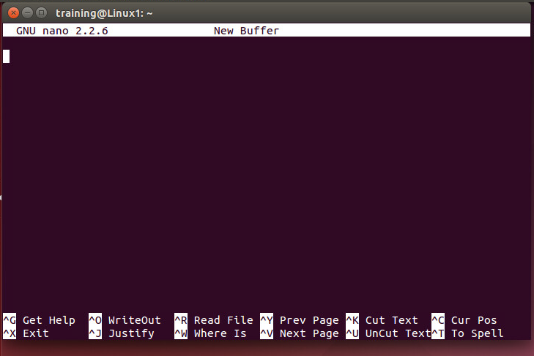
The Basics
Text Editors

Slide 35
The Basics
Text Editors
Using the shortcuts listed at the bottom of the screen you can navigate around the file.
To save and close the text file when you are done press Ctrl+X

Slide 36
The Basics
Wildcards, auto completes, command history, quick recall…
Notes:
Could do with some words of advice/caution when using 'rm', especially with wildcards. e.g. take extra care when deleting relative paths, even the in the current dir, in case you are not where you think you are. Use 'pwd' to check if necessary.
Also, the carpenter's rule .... "measure twice, cut once" ... check your command, flags and paths twice before you hit the enter key.

Slide 37
The Basics
When searching for files or directories with similar characters or strings in their names you can use one of two wildcards * and ? ? is used to match a single character * is used to match multiple characters When combining these commands with flags you are able to perform many different functions. A prime example would be the rm flag allowing you to delete multiple files and directories with a similar name.
When typing in commands and you need to insert a file name you can increase the speed and accuracy by using the tab key to autocomplete. This works best when you are using highly unique filenames, for less unique file names it will only partially complete the file name, up to the point it no longer becomes unique
The up and down arrow keys will recall previously typed commands and the left and right keys will allow you to edit them. The history command will also allow you to see a list of previously typed commands.
Notes:
Could do with some words of advice/caution when using 'rm', especially with wildcards. e.g. take extra care when deleting relative paths, even the in the current dir, in case you are not where you think you are. Use 'pwd' to check if necessary.
Also, the carpenter's rule .... "measure twice, cut once" ... check your command, flags and paths twice before you hit the enter key.

Slide 38
The Summary
Linux is not scary, it’s just taking you out of your comfort zone of GUI based operating systems. The Linux community is superb and there are thousands upon thousands of helpful guides, forums and users out there willing to share knowledge and help the new Linux user.

Slide 39

The Summary

Slide 40

Image description Credit: photographer

